Slide 1
AI-Enhanced Medical Image And Diagnostic Platform
Team Members
P.Suneel Kumar (Team Leader)
A.Mohan sai
C.Chiranjeevi
E.Vijaya Lakshmi
N.Vinod Kumar
R.Likitha
Y.Chandu

Slide 2
INDEX
Project Overview
Problem StatementTechnologies Used
Reasons for Choosing the Project
Implementations in the Project
Technologies Used
Application Structure
Text Processing
Image Processing
Input Data Handling
Output and Results
Challenges faced

Slide 3
Problem Statement
Limited Access to Healthcare
Inefficiencies in Disease Diagnosis
Complexity of Symptom Interpretation
High Costs of Healthcare Services
Data Overload
Reasons for Choosing the Project
Impact on Healthcare
Advancement of Technology
Addressing Real-World Problems
Personal Interest in Medicine andTechnology
Challenge and Learning Opportunity

Slide 4
Overview
This Platform integrates various inputs such as text, audio, live recordings, and images to identify conditions using advanced techniques, offering precise recommendations for medications, safety precautions, and follow-up care.
Automate processes such as data processing, image analysis, and text conversion to improve efficiency and reduce manual workload.
Offer advanced diagnostic capabilities and real-time health monitoring, particularly for remote areas or users with limited access to healthcare facilities
Objective
Multi-Modal Submission: Enable users to submit symptoms through text, audio, live recordings, or images for comprehensive analysis.
AI-Powered Disease Identification: Utilize machine learning models and natural language processing (NLP) techniques to provide accurate predictions and insights into potential health conditions based on user inputs.
User-Friendly Interface: Develop a responsive and accessible front-end to ensure ease of use.

Slide 5
Project Architecture and Workflow
1.
Collect Required Data
2.
Upload Data
User Input Selection
3.
Processing Based on User Input
Option 1: Text Input (Chatbot)
Option 2: Image Input
Option 3: Audio Input
4.
Output Results
(Display Identified Diseases, Provide Disease Descriptions)
5.

Slide 6
Application Structure
Chatbot Functionality
Input:
Users provide symptoms via text input.
Process:
The chatbot engages in an interactive dialogue, asking clarifying questions to gather more details about the symptoms.
Output:
Based on the gathered information, the chatbot identifies potential diseases and offers detailed descriptions of the conditions based on user demands.
1
Image Input Handling
Input:
Users can upload images of symptoms or conditions.
Process:
Images are stored in Azure Blob Storage.
The application extracts features from the uploaded images and analyzes them using Azure Custom Vision.
Output:
The system determines whether the condition shown in the image indicates a disease and provides the name of the identified disease.
2

Slide 7
Application Structure
Audio Input Processing
Input:
Users can provide symptoms via audio input in two formats:
Live Audio: Users can record their symptoms in real time.
Recorded Audio: Users can upload pre-recorded audio files.
Process:
Both audio formats are converted to WAV format for processing.
Speech recognition is used to extract text from the audio input.
Output:
The extracted text is analyzed to identify potential diseases, and the results are presented to the user.
3

Slide 8
Implementations in the Project
Multimodal Input Handling
AI-Powered Disease Prediction
Integration of Azure Services
Natural Language Processing
Image Analysis
Real-Time Audio Processing
User-Friendly Interface
Data Storage Solutions
Dynamic Response Mechanism
Comprehensive Output Reporting

Slide 9

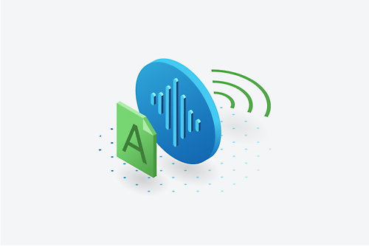

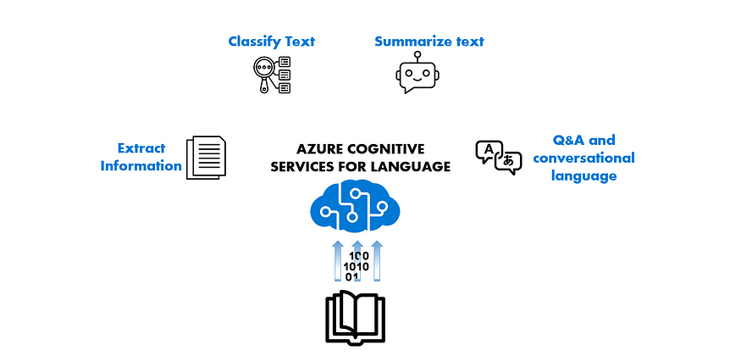
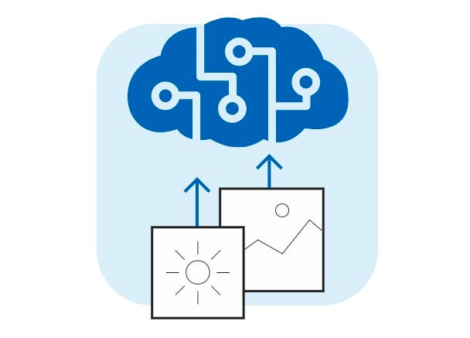

Technologies Used
Azure Health Bot
Azure Speech Services
Azure Translator
Azure Language Services
Azure Custom Vision
Azure Blob Storage

Slide 10
1.Chatbot
Requirements
Azure Health Bot
FastApi
Template
Logging
Jinja2Templates

Slide 11
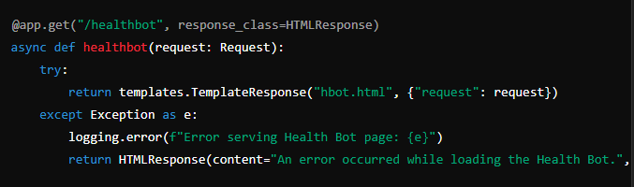
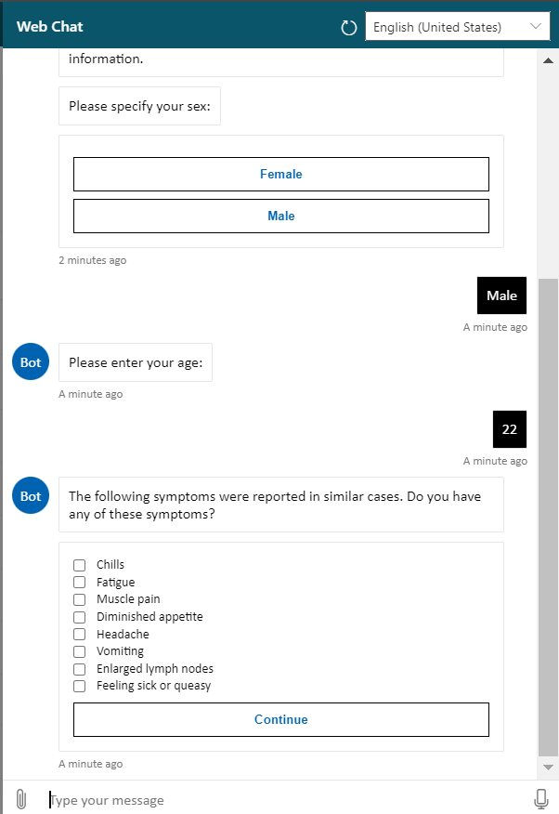
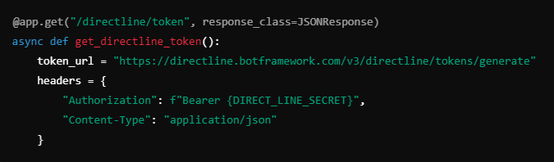
Text input
Chatbot
Chatbot Ui Code
Chatbot Output Interface
Chatbot Integration code with Sdk

Slide 12
1.Text Input
PYTHON MODULES\FUNCTIONS
Pydantic
Data Model
SymptomsInput()
Text Analysis
analyze_text_with_azure()
Translation
translate_text()
Endpoint Handling
handle_text()
Azure Services Used
Azure Text Analytics
Azure Translator
Supported formats (.txt, .pdf, .docx, .pptx, .xlsx, .csv, .json, .xml)

Slide 13
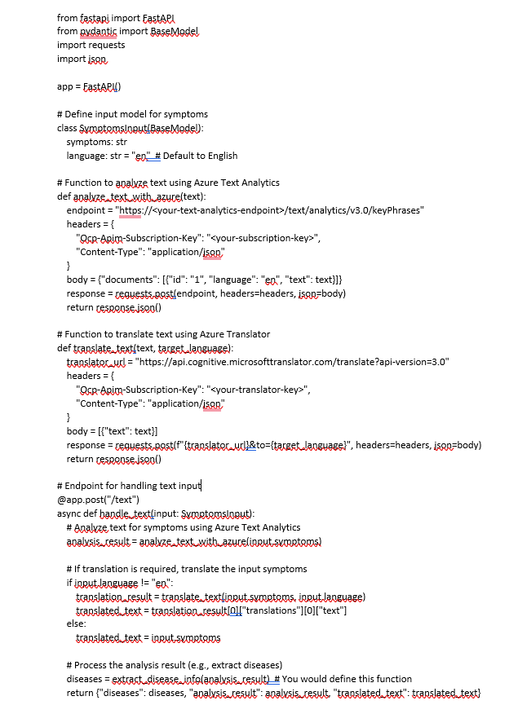
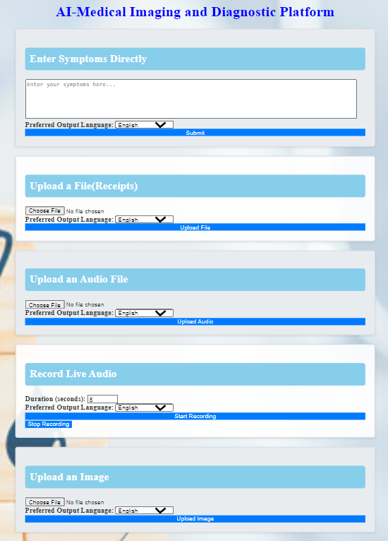
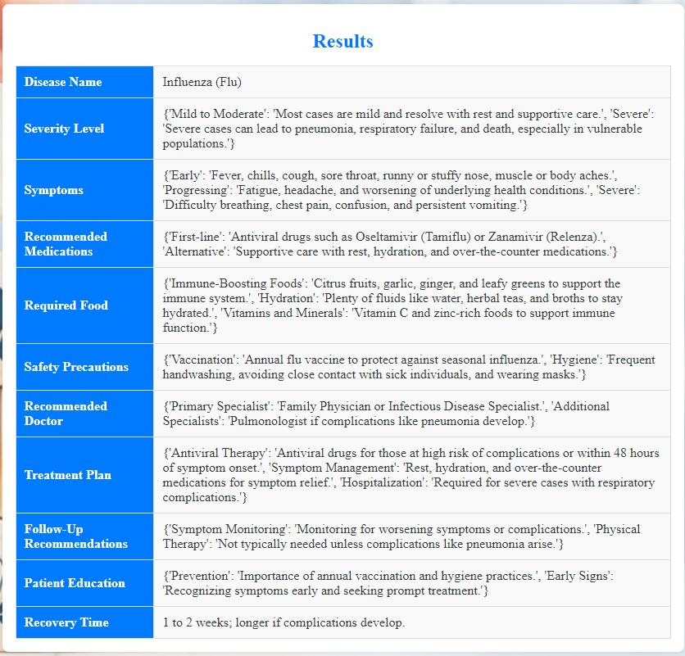
Text input
1. Text Input
Input: Text input UI
Input: Text input Code snippet
Output for Text input

Slide 14
2. Audio Processing
Python Modules
Pydub
SpeechRecognition
PyAudio
Wave
Azure Services Used
Azure Speech Service
Requirements

Slide 15
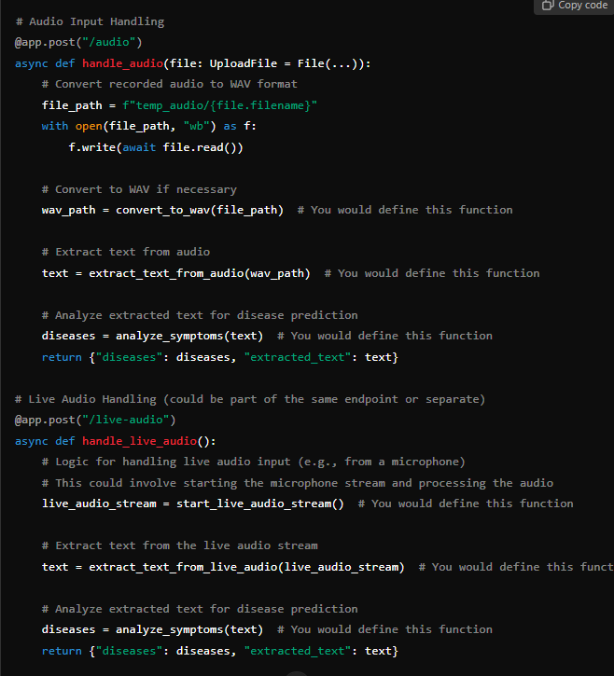
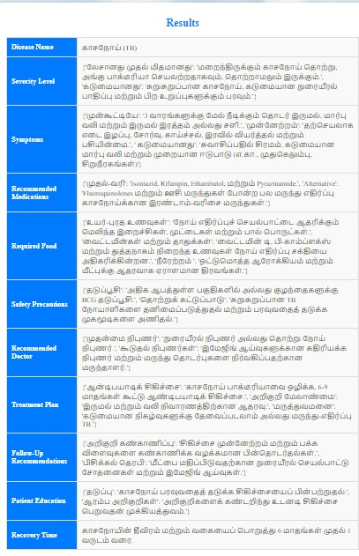
2. Audio Processing
Input: Code snippet
Output: Description, Recommendations

Slide 16
3. Image Processing
PYTHON MODULES\FUNCTIONS
Pillow (PIL)
File Upload Handling
handle_image(Function)
Image Conversion
Image Analysis
analyze_image_with_custom_vision(Function)
Result Processing
extract_disease_info(Function)
Azure Services Used
Azure Custom Vision

Slide 17
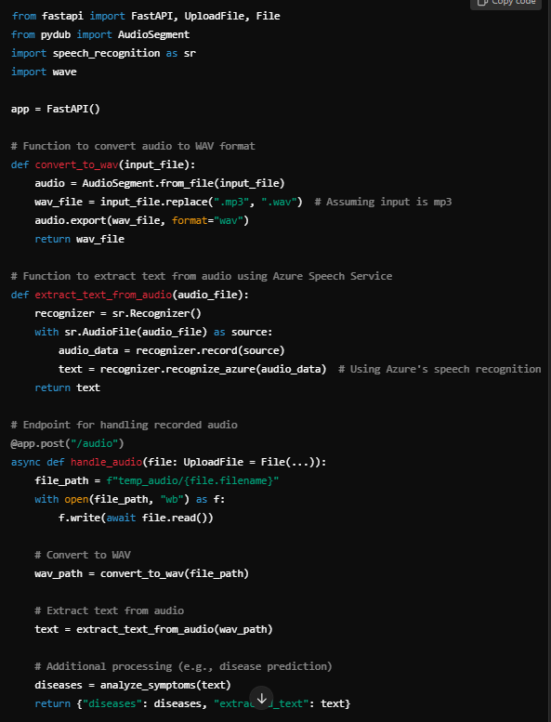
3. Image Processing
Audio input (UI)
Input: Code snippet
Output for audio input

Slide 18
Output and Results
INPUT
OUTPUT

Slide 19
Challenges Faced
Data Collection and Quality
Integration of Multiple Input Types
Natural Language Processing (NLP) Challenges
Audio Processing Difficulties
Image Analysis Accuracy
User Experience Design
Security and Privacy Concerns
Model Training and Validation
Real-Time Processing
Maintenance and Scalability

Slide 20
Conclusion
This project leverages cutting-edge AI technology to transform the way we diagnose and manage diseases like pneumonia. By integrating machine learning, natural language processing, and computer vision, it provides a comprehensive solution for analyzing symptoms, processing audio recordings, and interpreting medical images.
The system enhances accuracy by detecting subtle patterns and early signs of disease, improving the chances of successful treatment
Overall, this project aims to streamline healthcare, provide precise diagnoses, and offer personalized treatment recommendations, ultimately improving patient outcomes and making advanced medical care more widely available.

Slide 21

Thank you

